Slide 1
Innovative technologies for improving hospital revenue and energy savings
U K Ananthapadmanabhan
Director, Tenxhealth Technologies
19 June 2020

Slide 2
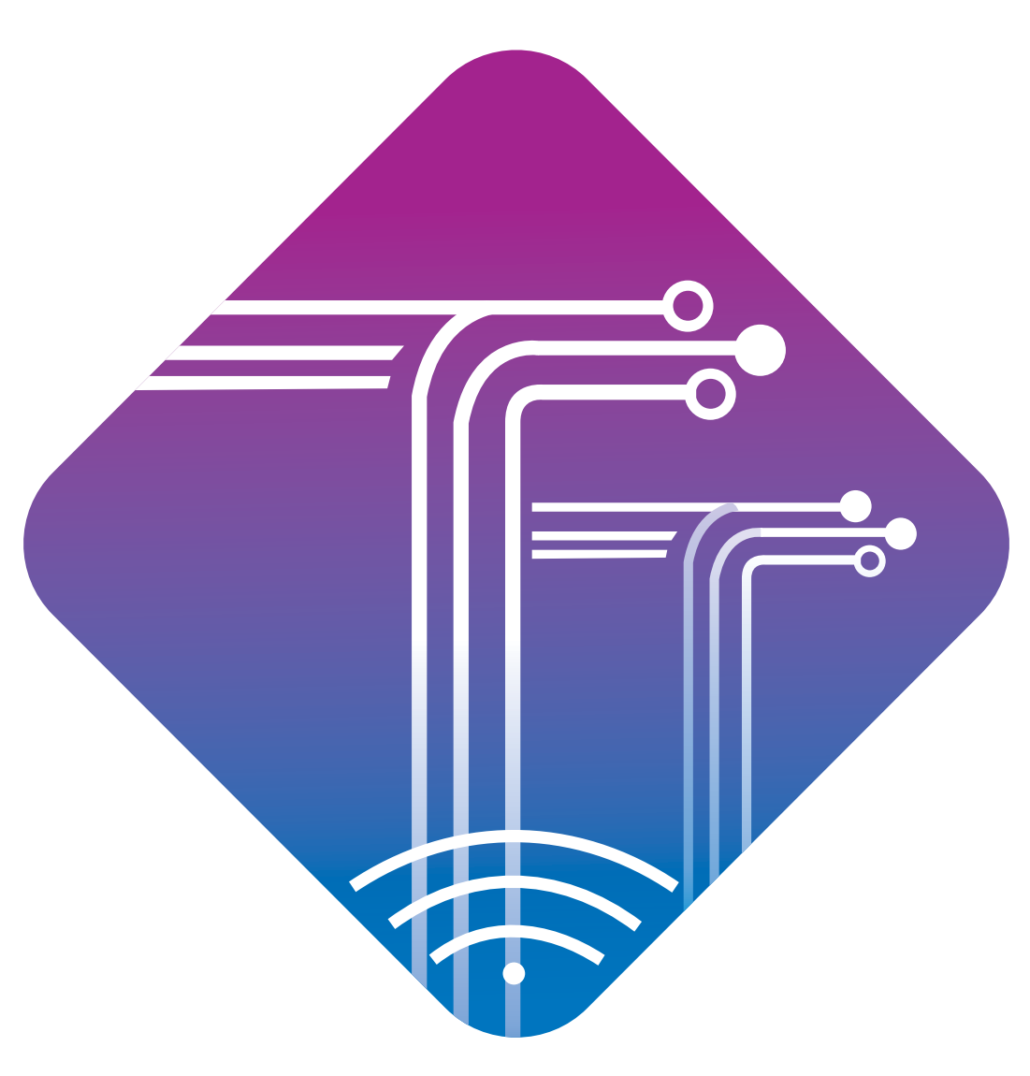
Industry 2.0
Industry 4.0
End of 18th century
Start of Mechanization by using steam and water power
1970
Use of computer to automate operations
X times PI
Start of 20th century
Emergence of Electricity & mass production techniques .% PI
Around 2010
Digital enterprises
Interoperable ecosystem of machines (IoT)
Exponential PI
Industry 1.0
Industry 3.0
Indian healthcare ready for Hospital 4.0 ?
. Tenxhealth Technologies Private Limited .

Slide 3
Innovative and disruptive technologies in healthcare
IOT /IIOT/IMT
ML/NLP/DL
Big Data
BLE/NB IoT/LoRa /WiFi /Zigbee
Artificial Intelligence(AI)
Mobile
Quantum Computing
Augmented /Virtual reality
Internet
Realtime location tracking system(RTLS)
Edge computing
Cloud Computing
Edge Computing
Pneumatics
Cloud computing
Nanotechnology
3D Technology
-Handwriting /
Voice recognition
Robotic Processes Automation (RPA)
Robotics
Drone
Genomics

Slide 4
What is IoT?
Internet of things (IoT) is a network of physical objects with embedded electronics, software, connectivity and people to exchange data, for intelligent applications and services

Slide 5
What can IoT do?
Monitor
Measure
Record
Communicate
Automate
Insights
Enable data driven process automation and control

Slide 6
Types of IoT sensors
Temperature and Humidity sensors
Level sensors
Water/gas/oil flow sensors
Energy sensors
Location sensors
Vibration sensors

Slide 7
IoT Architechture
IoT device /sensors/ gateways /Embeded software
Connectivity -LAN/BLE/WiFi/LoRa/NBIoT/Zigbee /3/4/5G
Cloud -AWS/Microsoft Azure/Google cloud
IOT platform-AWS/Microsoft Azure/Google/IBM
Security
Analytics /Dashboard/ML/AI

Slide 8
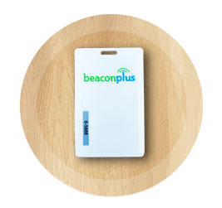
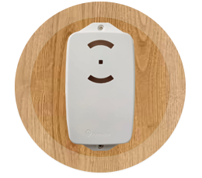
IoT technology overview
Beacon Tags/ Card/ Sensors -
Active cards transmitting BLE signals
Signals received by Cloud Sense
Uses the Wireless network
Cloud based location engine
Dashboards & Analytics

Slide 9
Technology convergence
Network Technologies
(LAN/BLE/Wi-fi/LoRa)
Cloud computing
Edge computing
IoT Eco system
Quantum Computing
Artificial Intelligence
Big Data
IoT
(Sensors & Devices)
Mobile

Slide 10
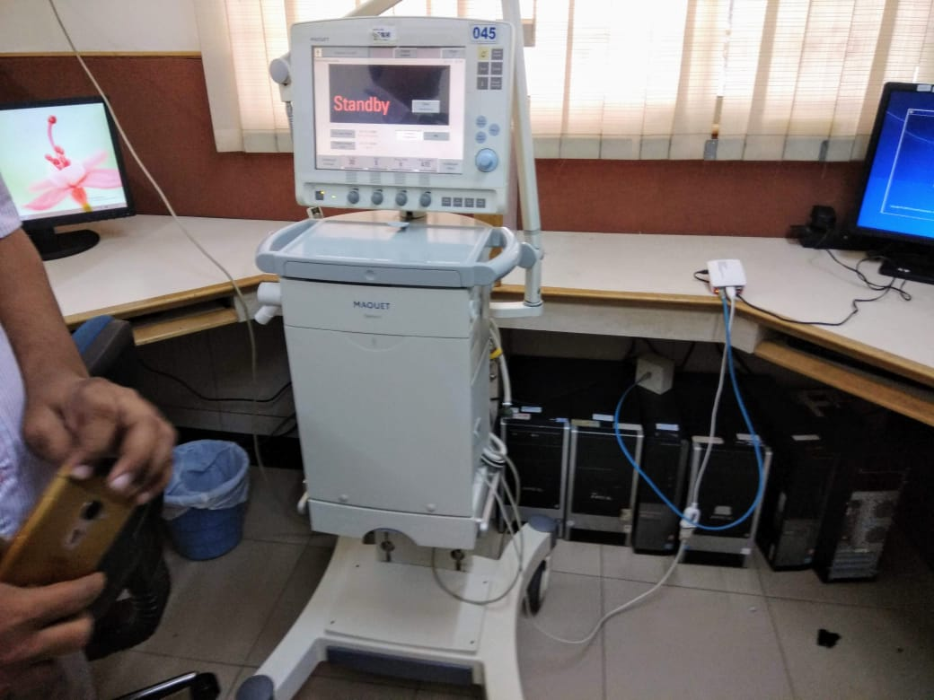
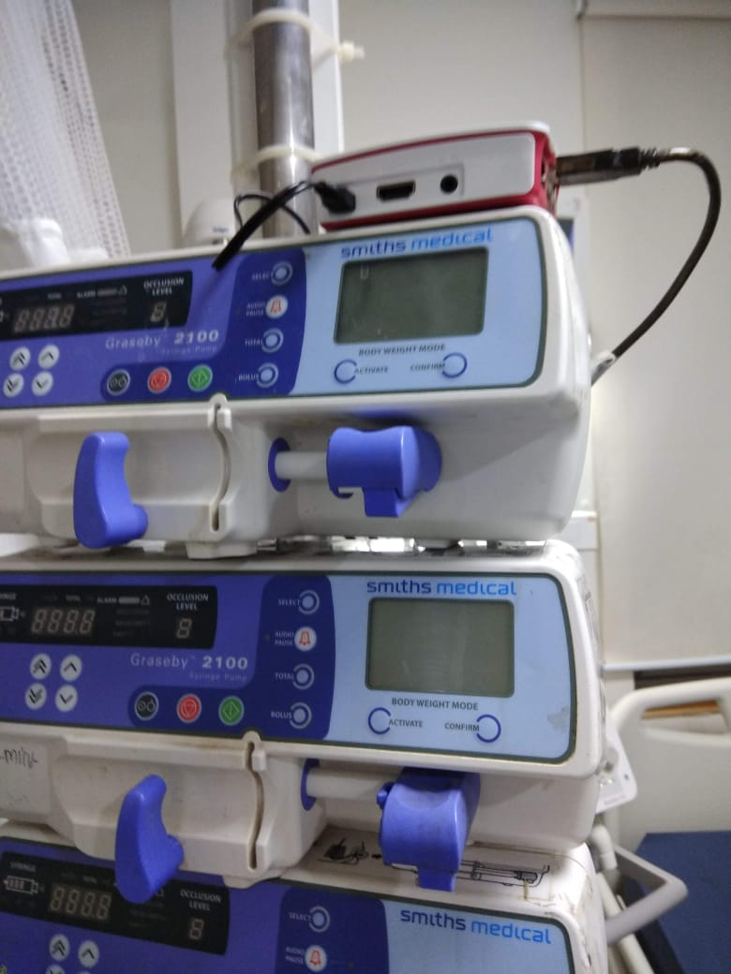
IoT sensors in medical equipment monitoring
Ventilator – Asset monitoring
Infusion pump – Asset monitoring

Slide 11
IoT Cloud
Location2
Location1
Location3
CtrlS cloud
Vodafone/Airtel provided Internet and Backup
Cloud service provider
EMR | HIS | IoT enabled applications | SAP
HIS
SAP
HR
Location7
Location3
Location7
Location5
Location4
Connectivity between locations are enabled by providers like Airtel, Vodafone
Servers and Data Centers are hosted on Cloud providers like AWS, CtrlS etc
Wireless connectivity inside a location by Ruckus , Cisco etc

Slide 12
What is a IoT platform?
A multi-layer technology which is used to manage and automate the connected devices is known as the IoT platform.
Helps to bring large number of physical objects online (e.g. sensors on equipment, wearable on patient to a single sign-on portal)

Slide 13
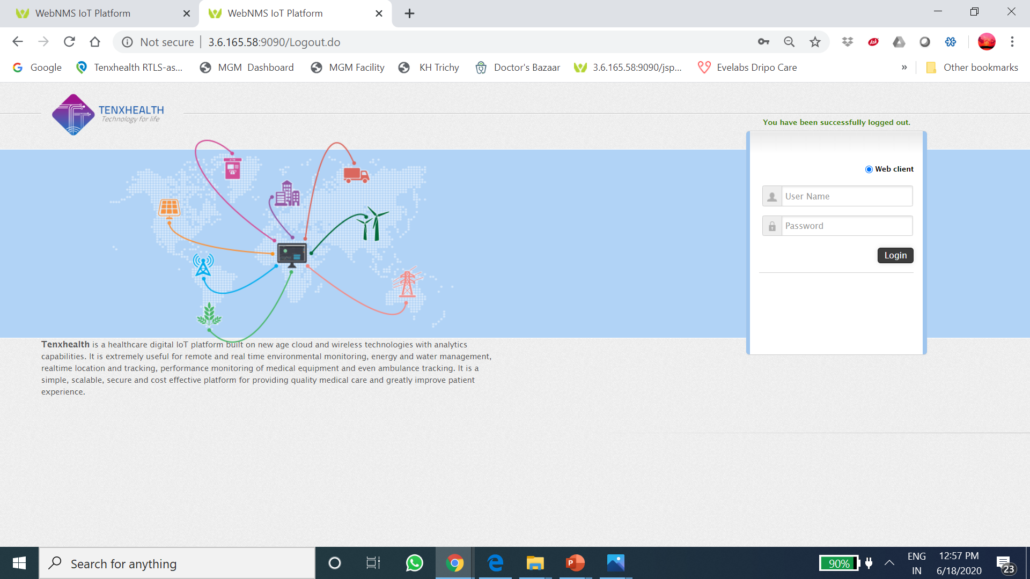
Healthcare IoT platform

Slide 14
Characteristics of IoT platform
Cost effective-Capex to Opex
Pay per use
Scalability
Maintainability
Standardization
Cost effectiveness (Capex to Opex)
Access from Any time, Any place ,Any device

Slide 15
Analytics/Dashboard

Slide 16
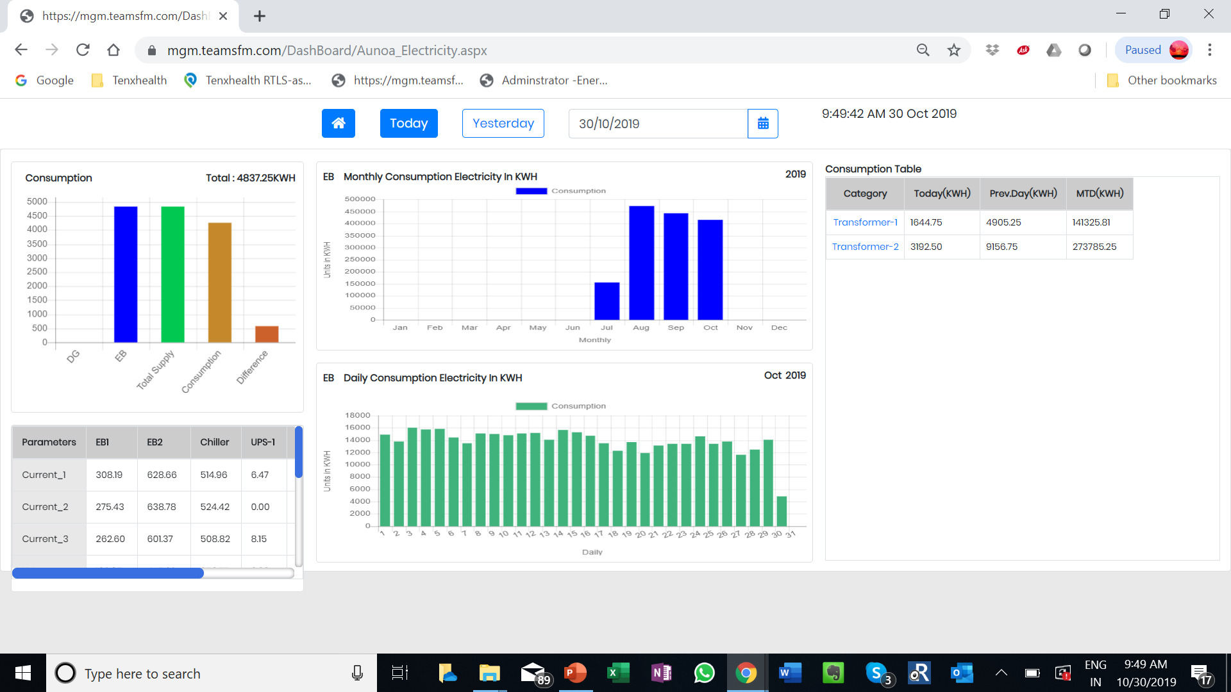

Slide 17
Existing IoT applications
Remote patient monitoring(DICU/Ward/Home)
Asset/Employee/Patient Tracking
Asset Performance/Utilization Monitoring
Environmental monitoring –Temperature /Humidity/Presure
Building management
Asset Management software/Supply Chain Management

Slide 18
Innovative IoT applications for Covid-19
Smart Sanitizers-Protech
Wireless infusion monitoring-Evelabs/Accuflow
Thermal temperature measurement and access control of people-Fevo
Odour sensors in wash rooms/Protech
Robots to deliver food and medicine/Disinfection

Slide 19
Benefits of IoT
Revenue optimization
(OT charges /Medical Equipment Billing)
Regulatory Compliance
(NABH)
Operations efficiency
(Minimize Waiting / TAT)
Risk management
(Alerts and notifications)
Cost reduction
(Manpower/Energy savings )

Slide 20
Challenges in IoT implementation
Leadership vision for IoT as a strategy?
Cybersecurity issues?
Perceived cost of implementation
Service and maintenance of IoT infra
Inadequate skillset for IoT adoption
Resistance to change and transparency

Slide 21
Healthcare IoT Platform demo

Slide 22
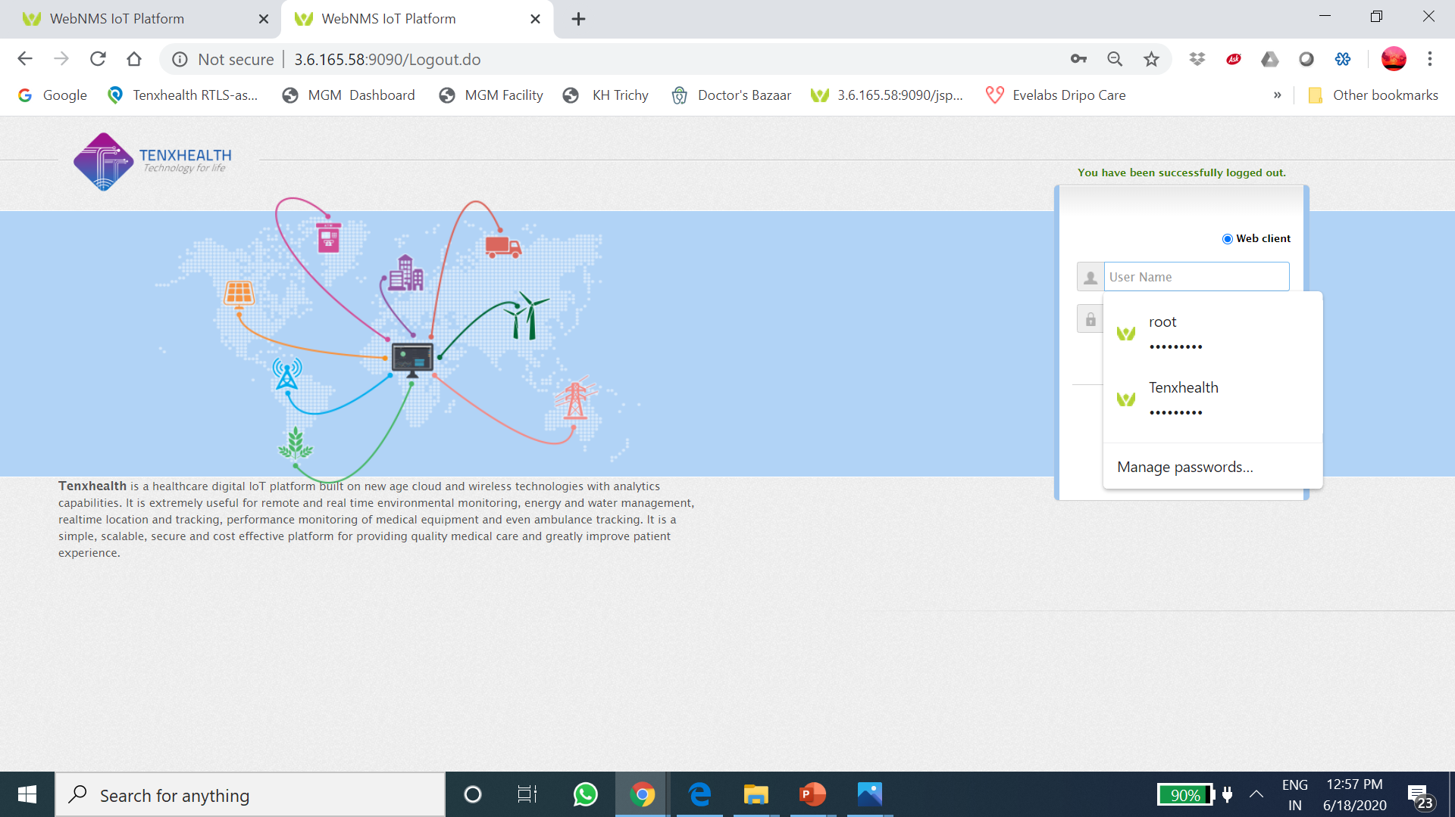

Slide 23
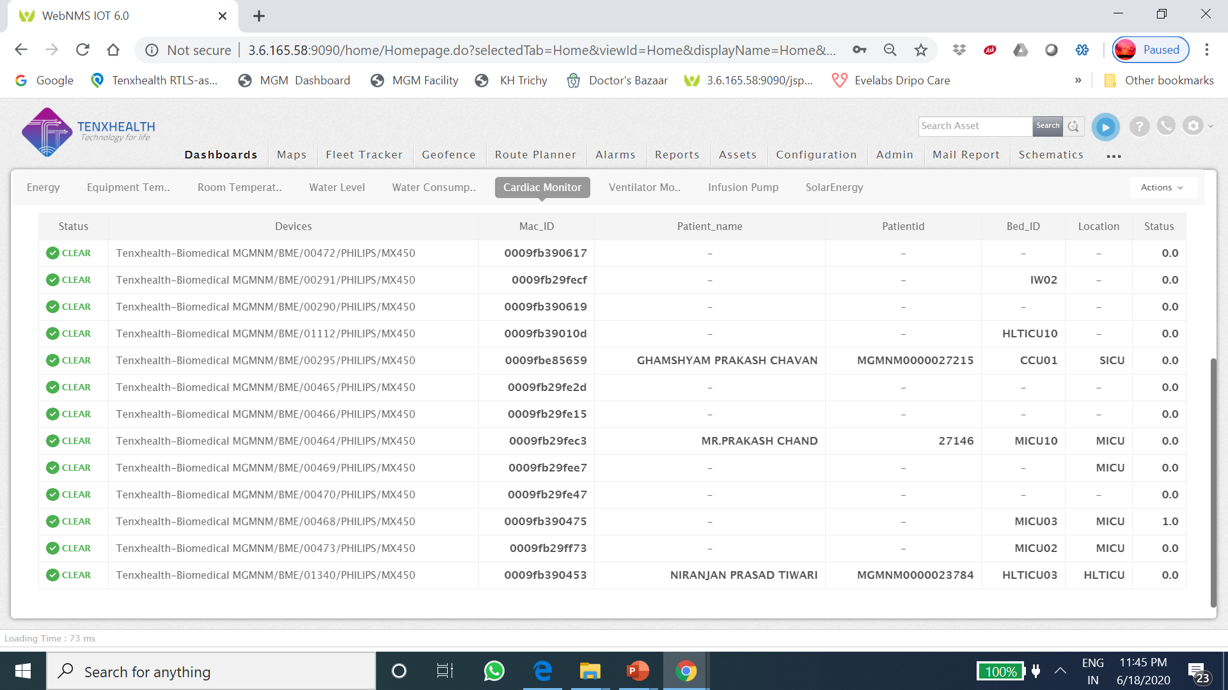

Slide 24
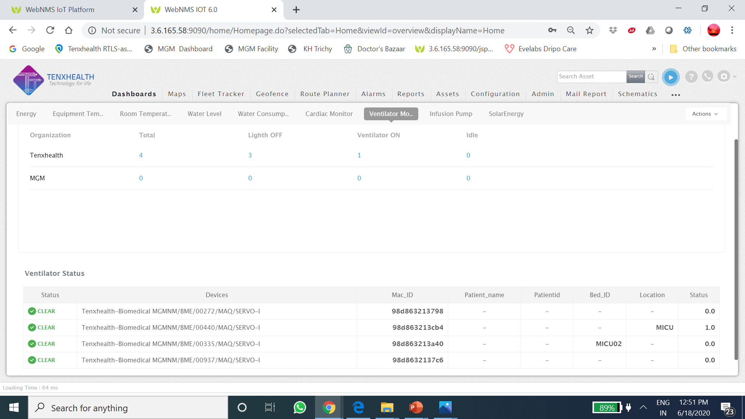

Slide 25
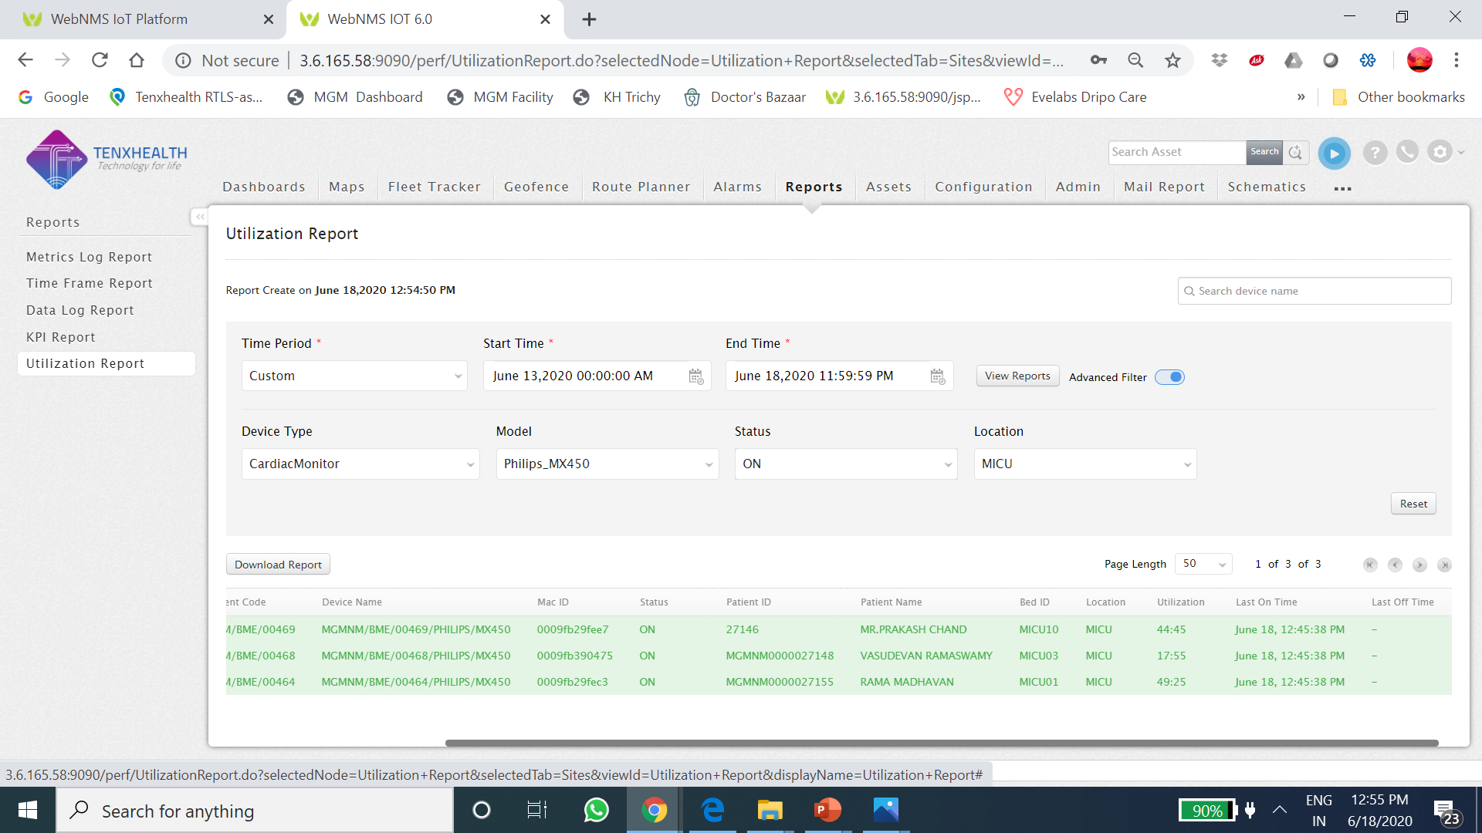

Slide 26
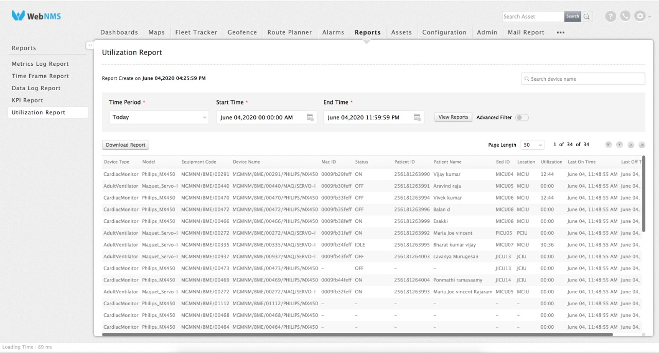

Slide 27
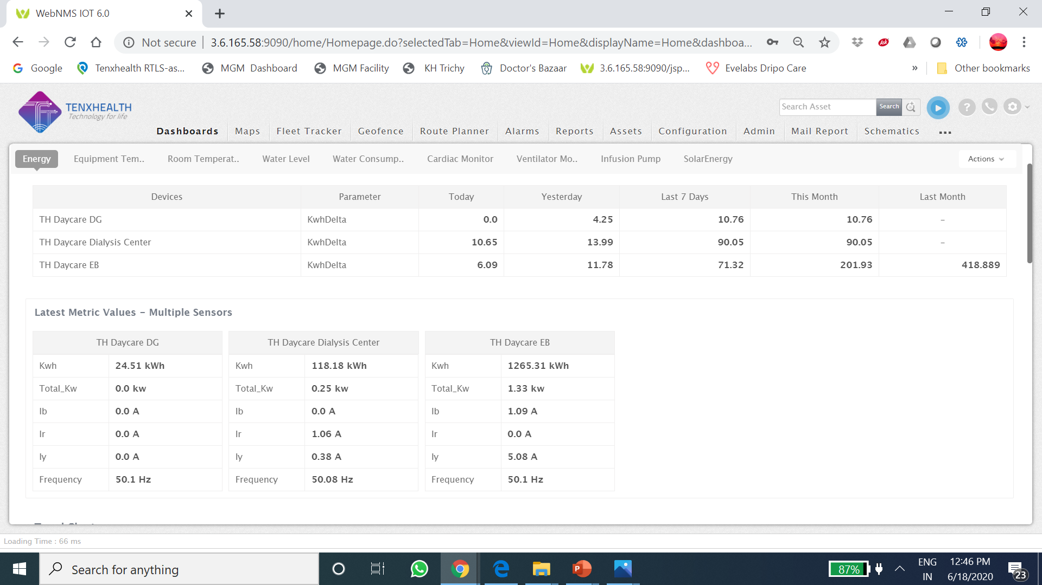

Slide 28
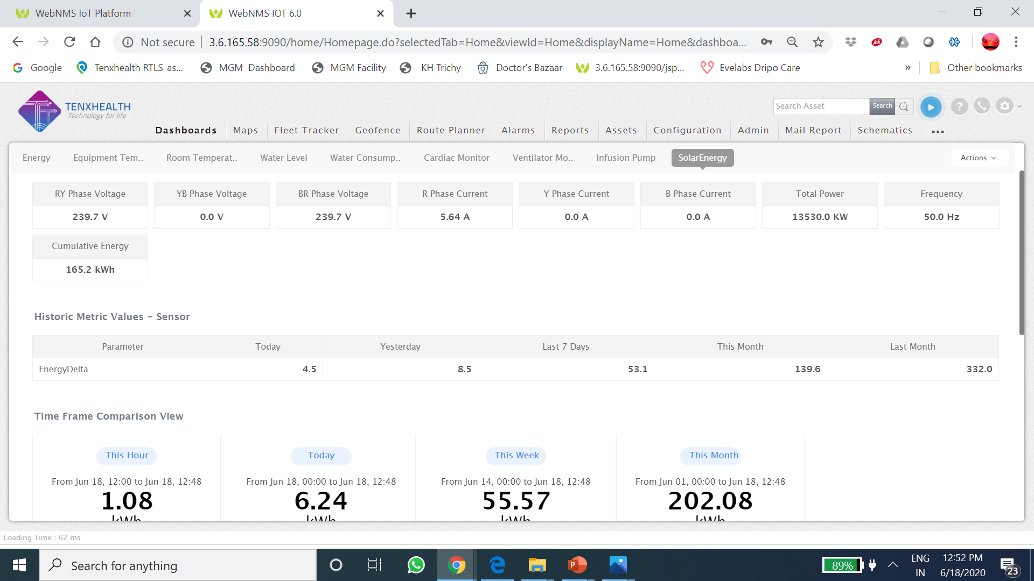

Slide 29
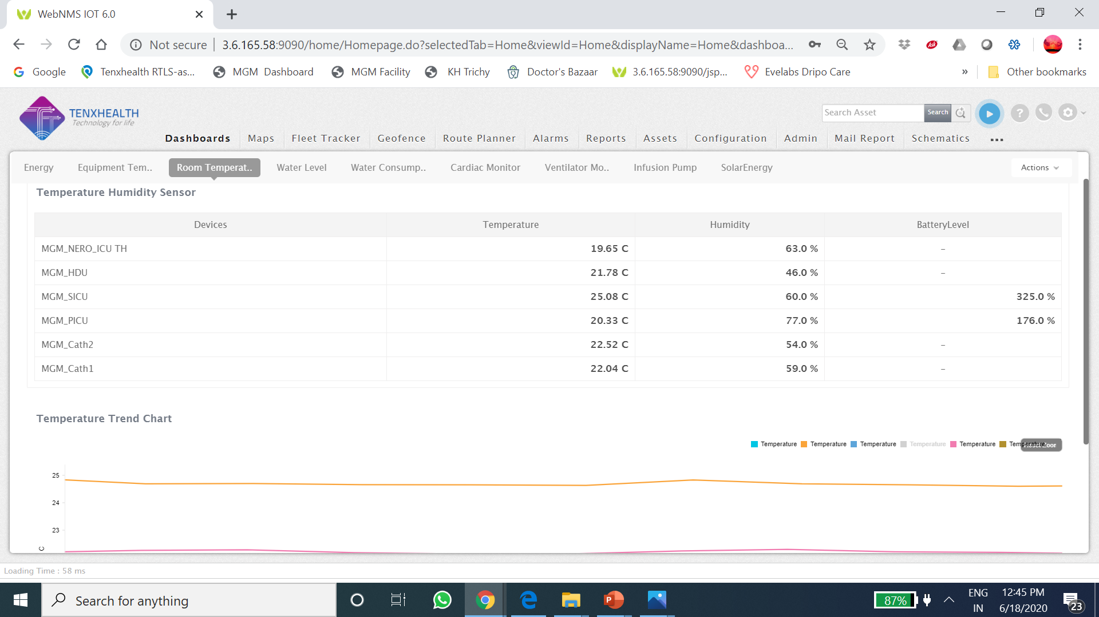

Slide 30
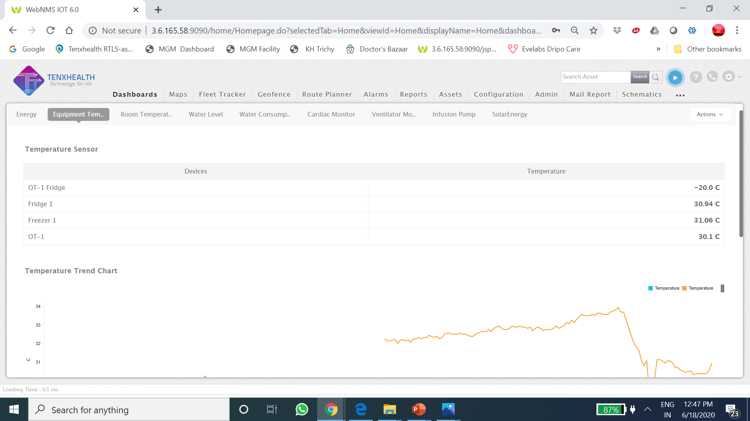

Slide 31
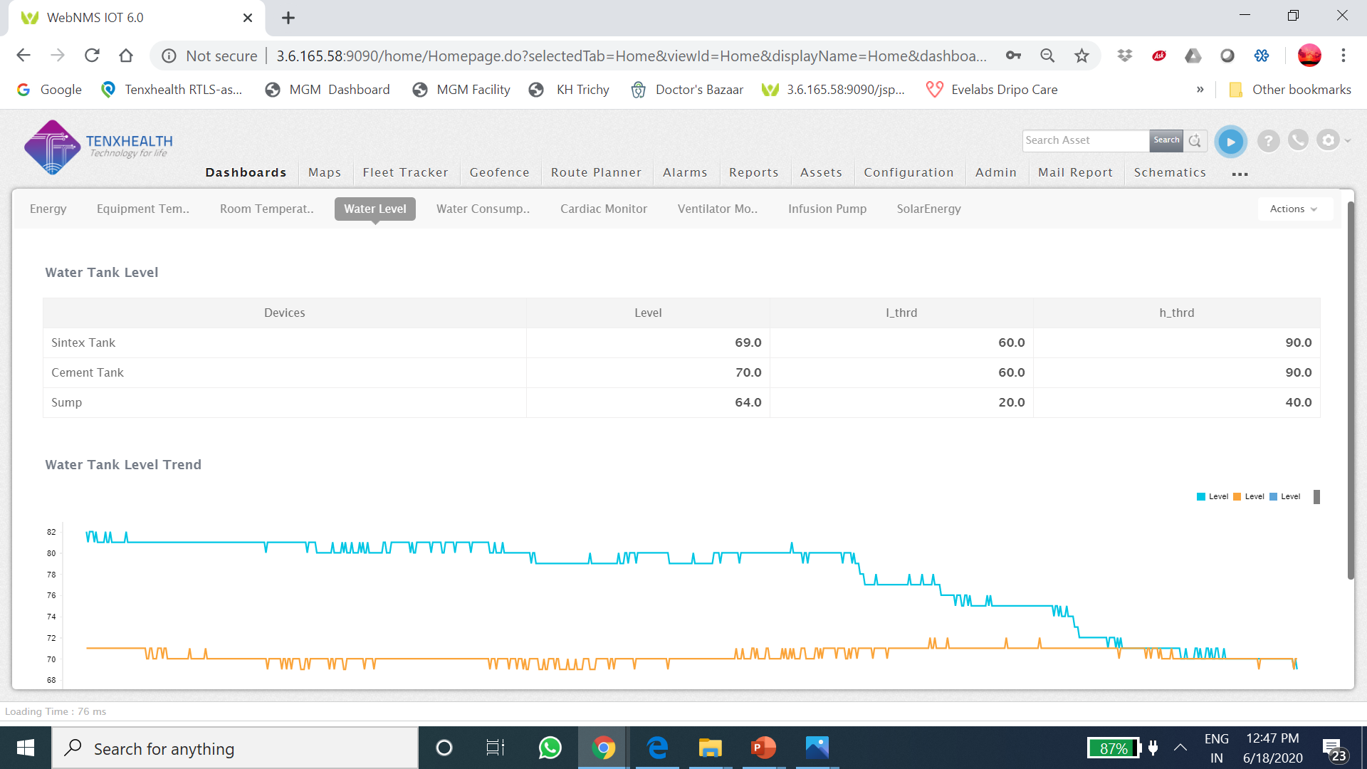

Slide 32
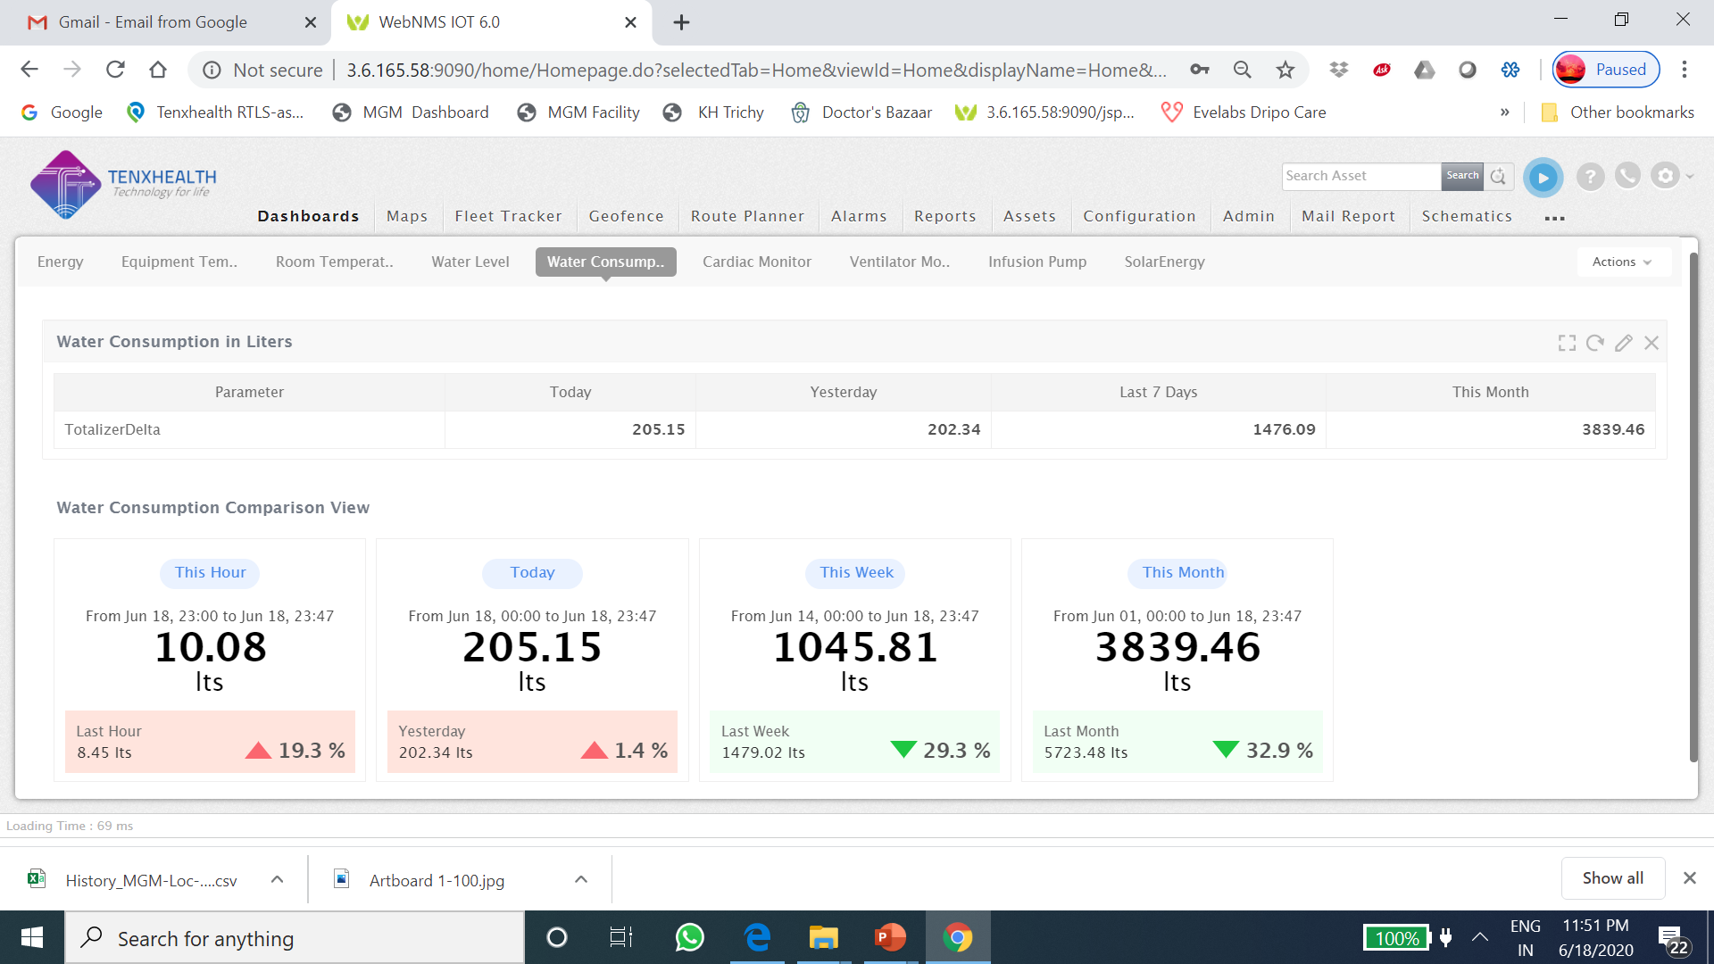

Slide 33
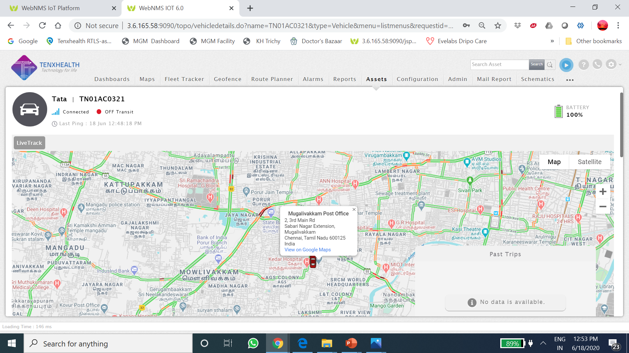

Slide 34
Charting solution

Slide 35
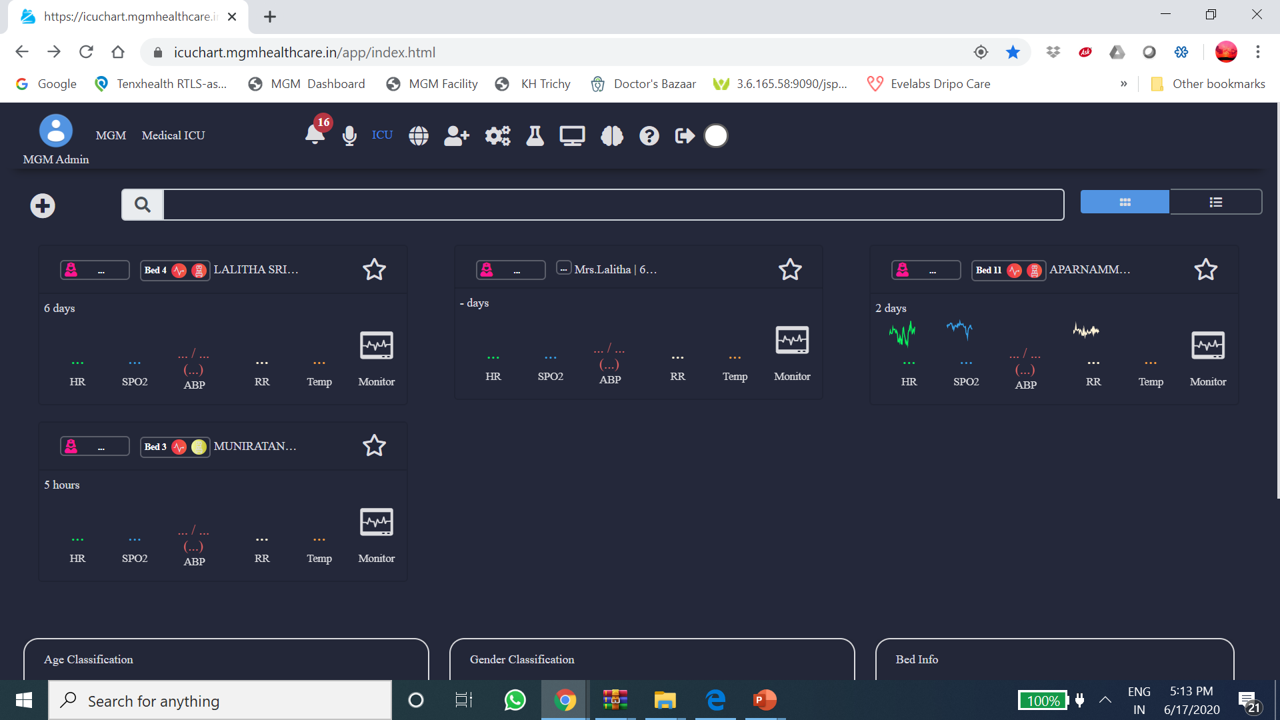

Slide 36
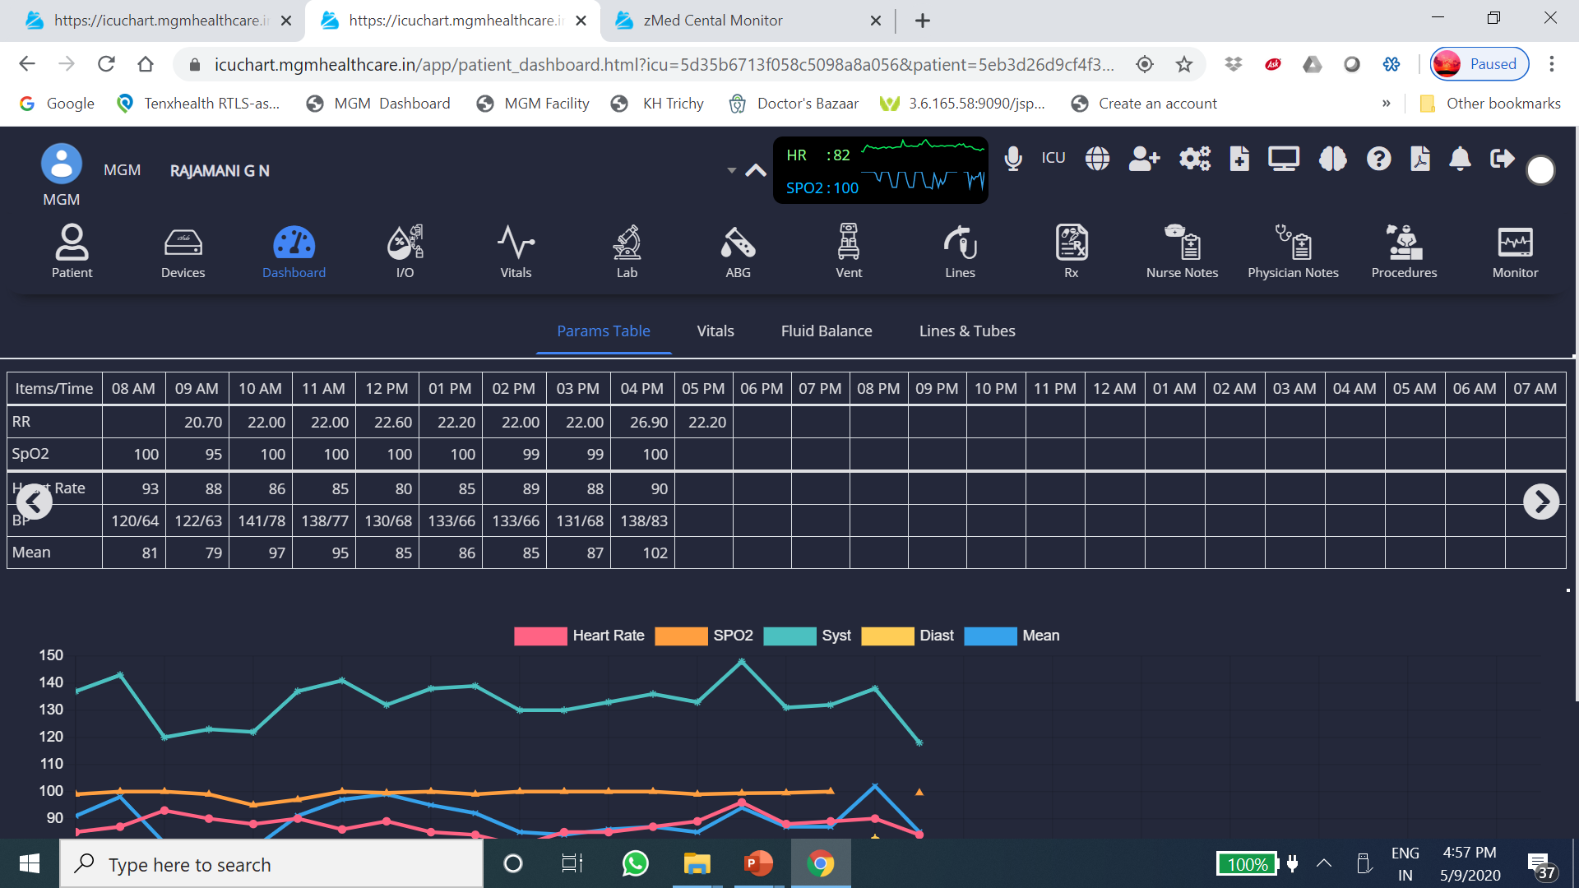

Slide 37
Asset Monitoring using IoT

Slide 39
Wireless online Infusion monitor

Slide 40
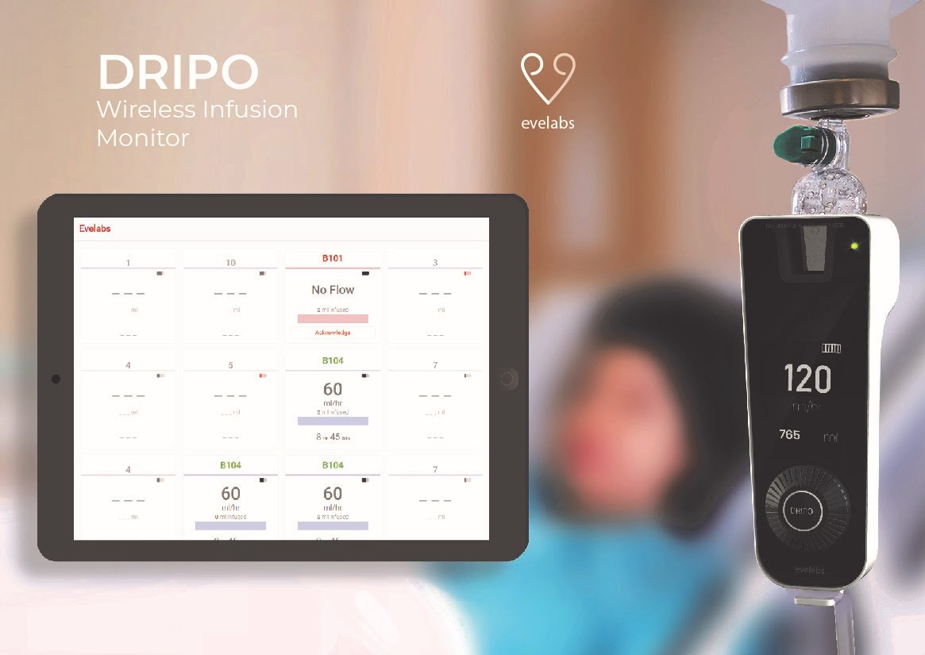

Slide 41
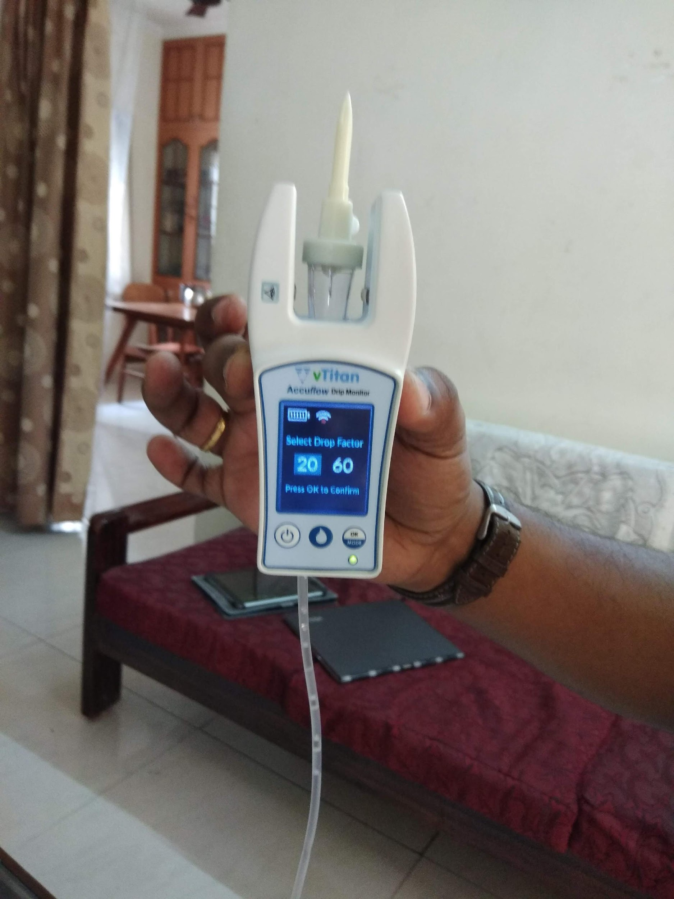

Slide 42
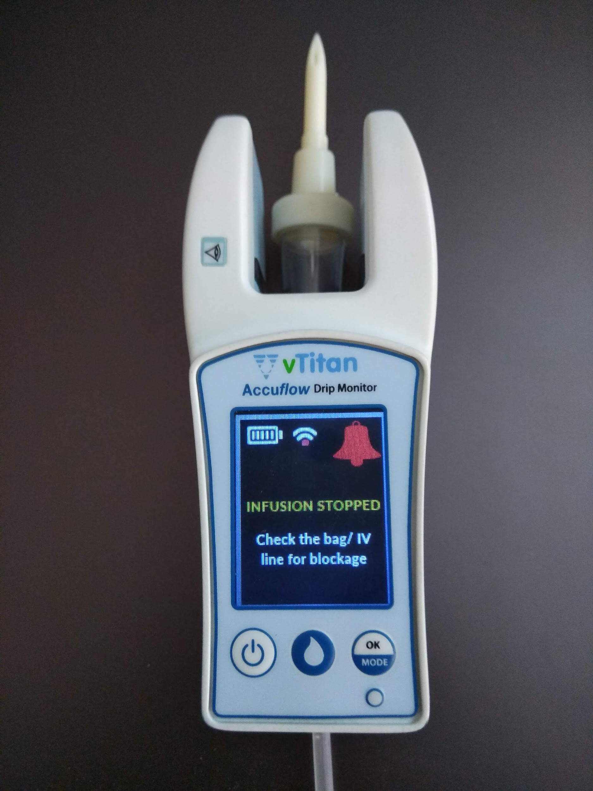

Slide 43
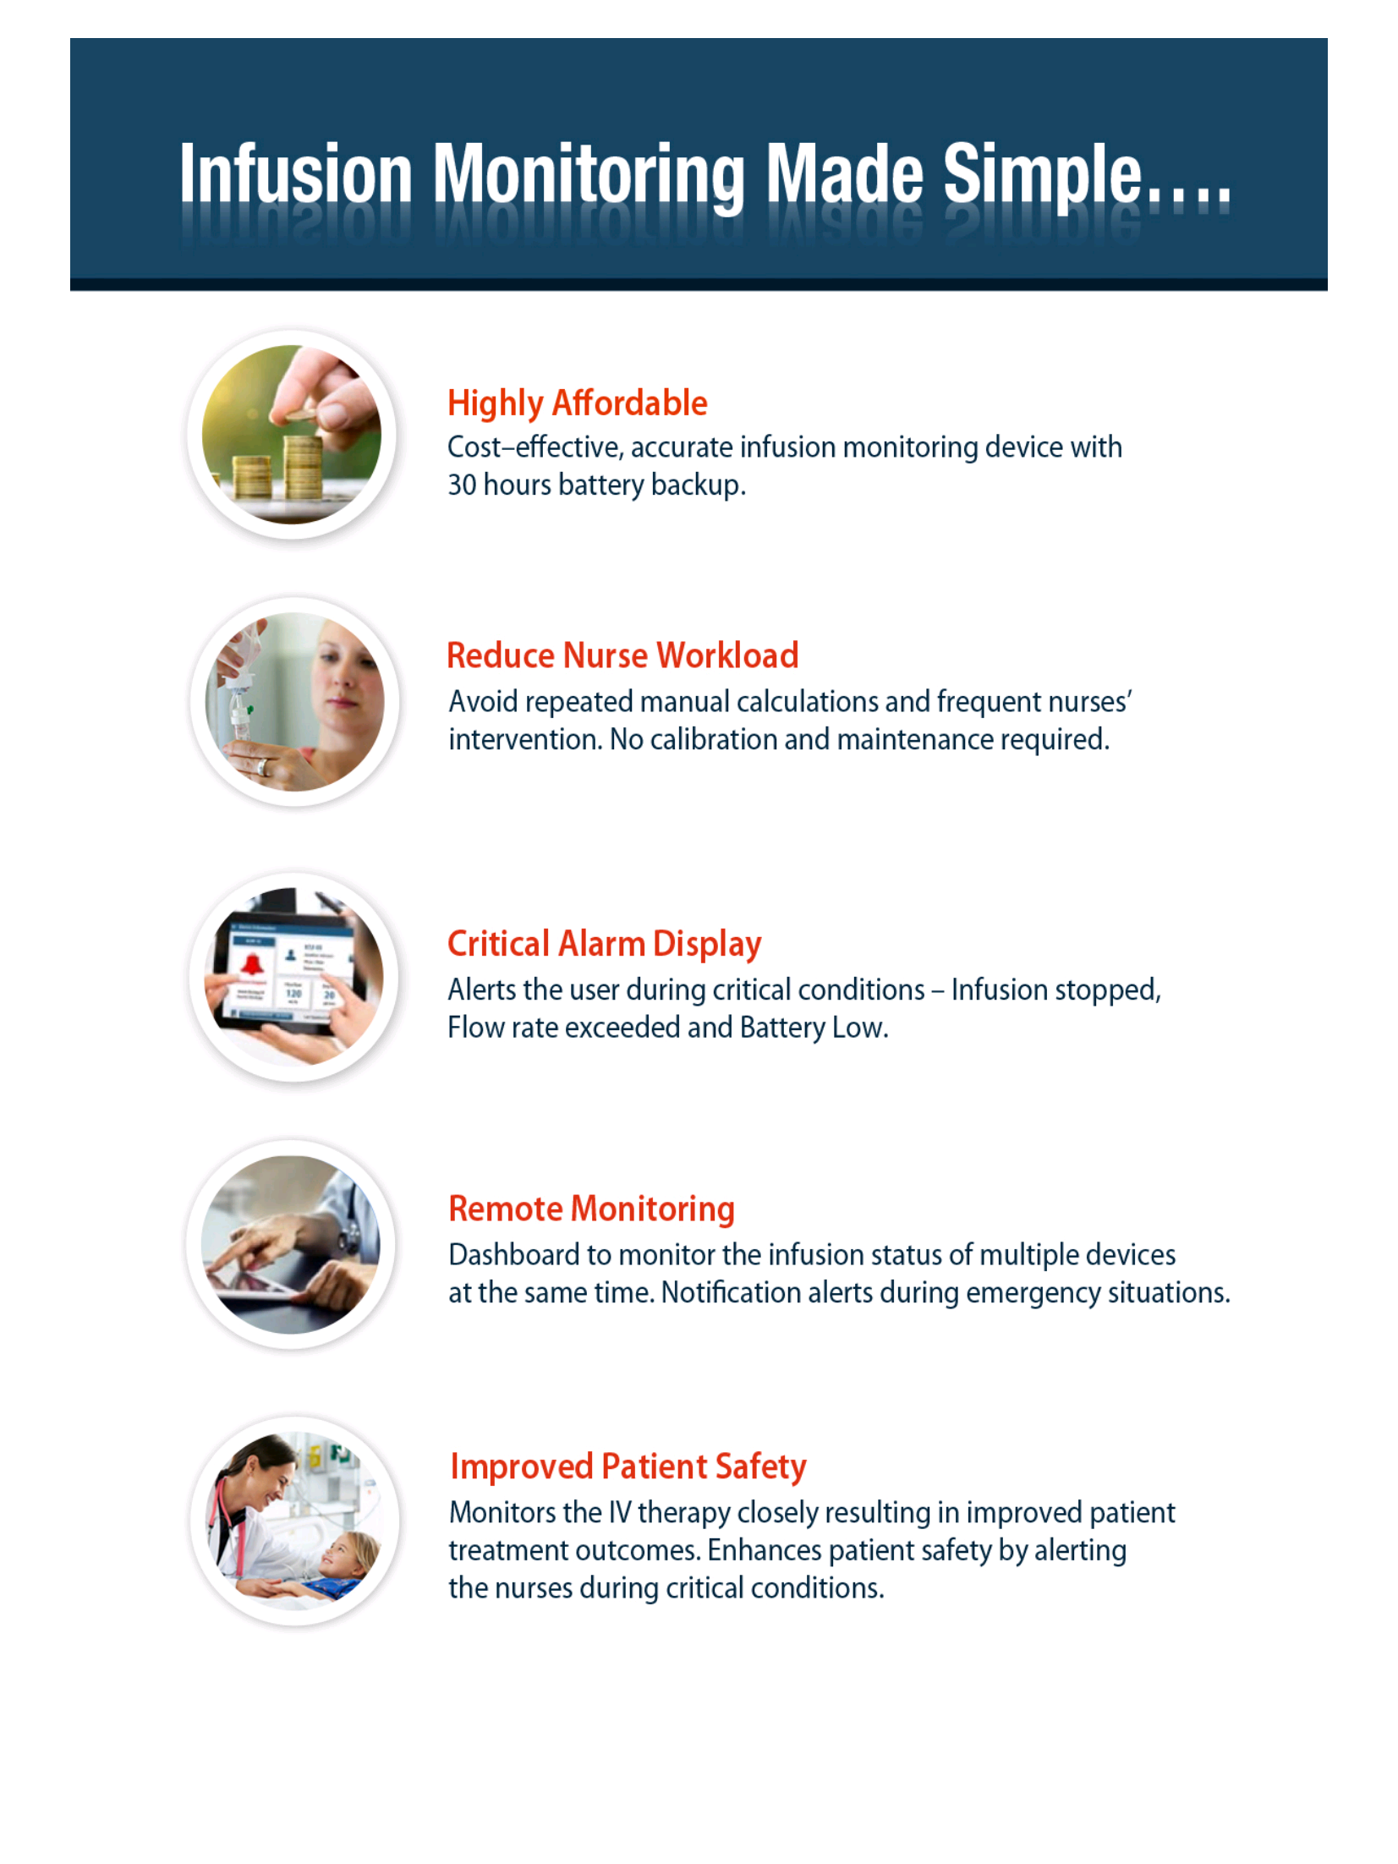

Slide 44
Wireless sanitizer dispenser

Slide 46
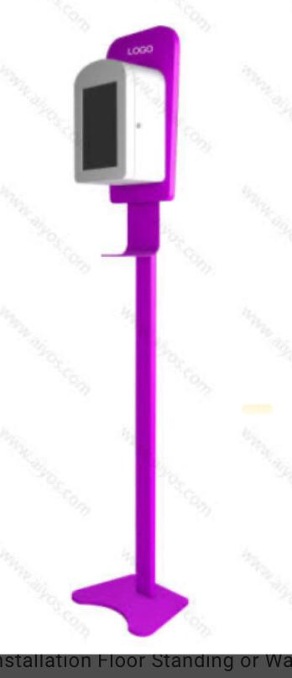

Slide 47
Real time location tracking -
Patient and asset tracking

Slide 48
What is Real time tracking system ?
Real-time locating systems (RTLS) are used to automatically identify and track the location of objects or people in real time, usually within a building or other contained area.
Wireless RTLS tags are attached to objects or worn by people, and in most RTLS, fixed reference points receive wireless signals from tags to determine their location

Slide 49
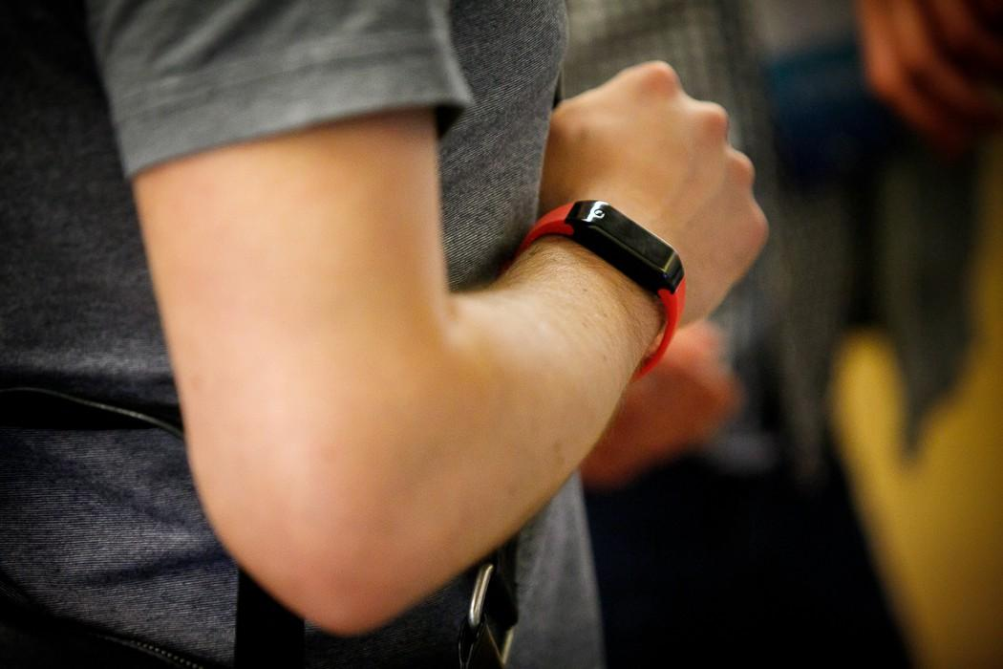
Patient and Asset Tags
Patient with wrist band tag
Syringe Pump with asset tag

Slide 50
Technology Overview
Beacon Tags/ Card/ Sensors -
Active cards transmitting BLE signals
Signals received by Cloud Sense
Uses the Wireless network
Cloud based location engine
Dashboards & Analytics

Slide 51
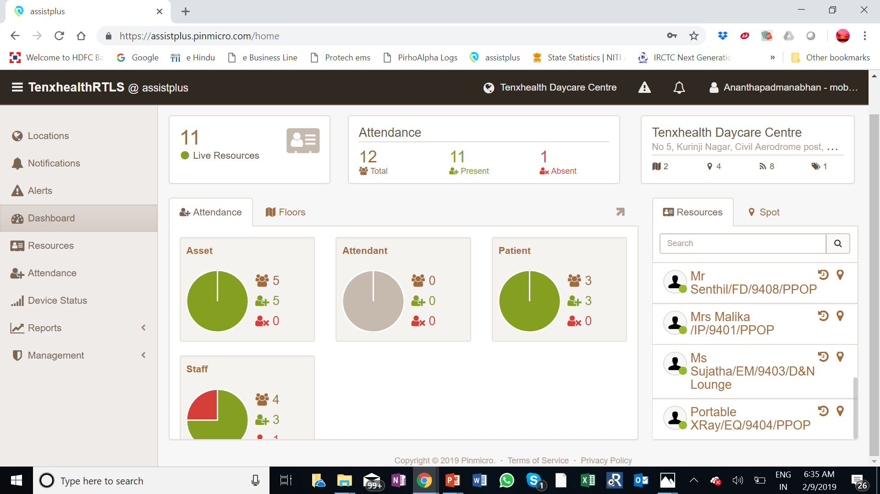

Slide 52
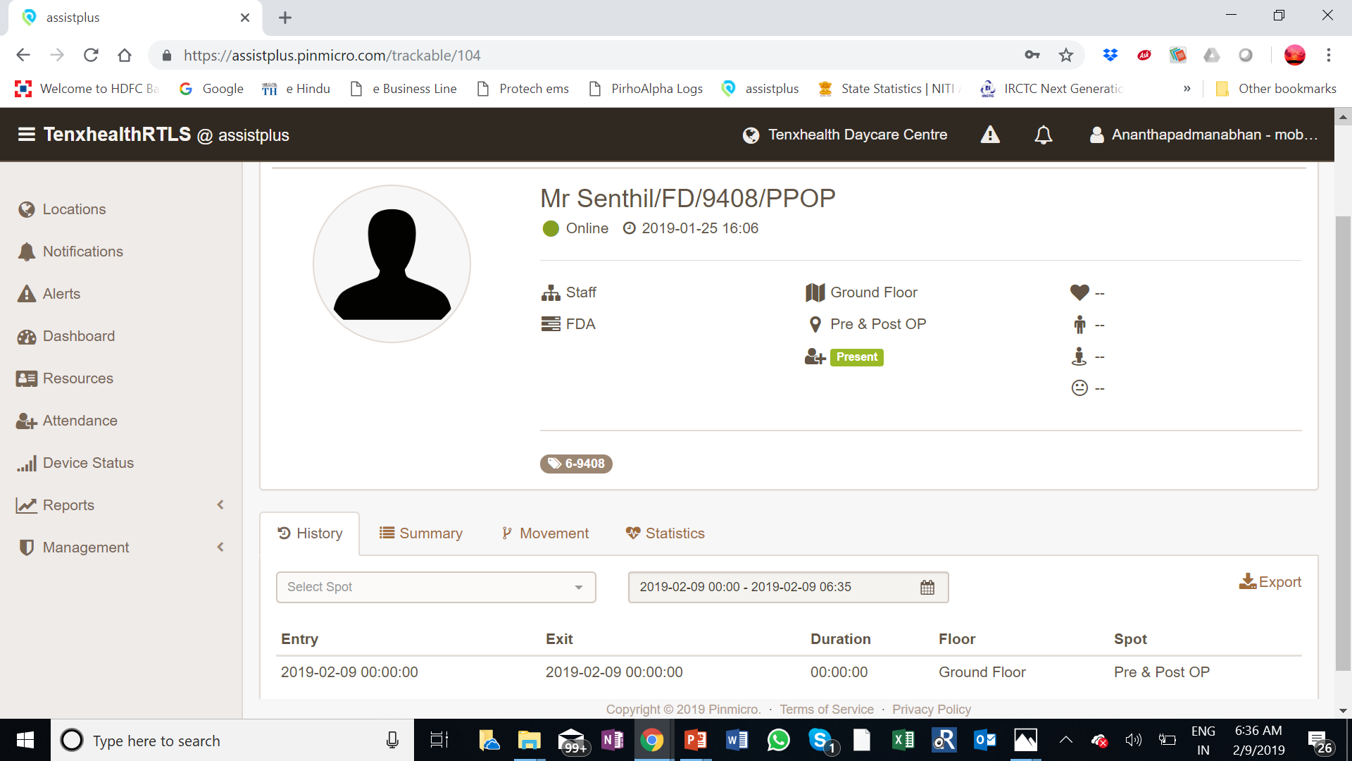

Slide 53
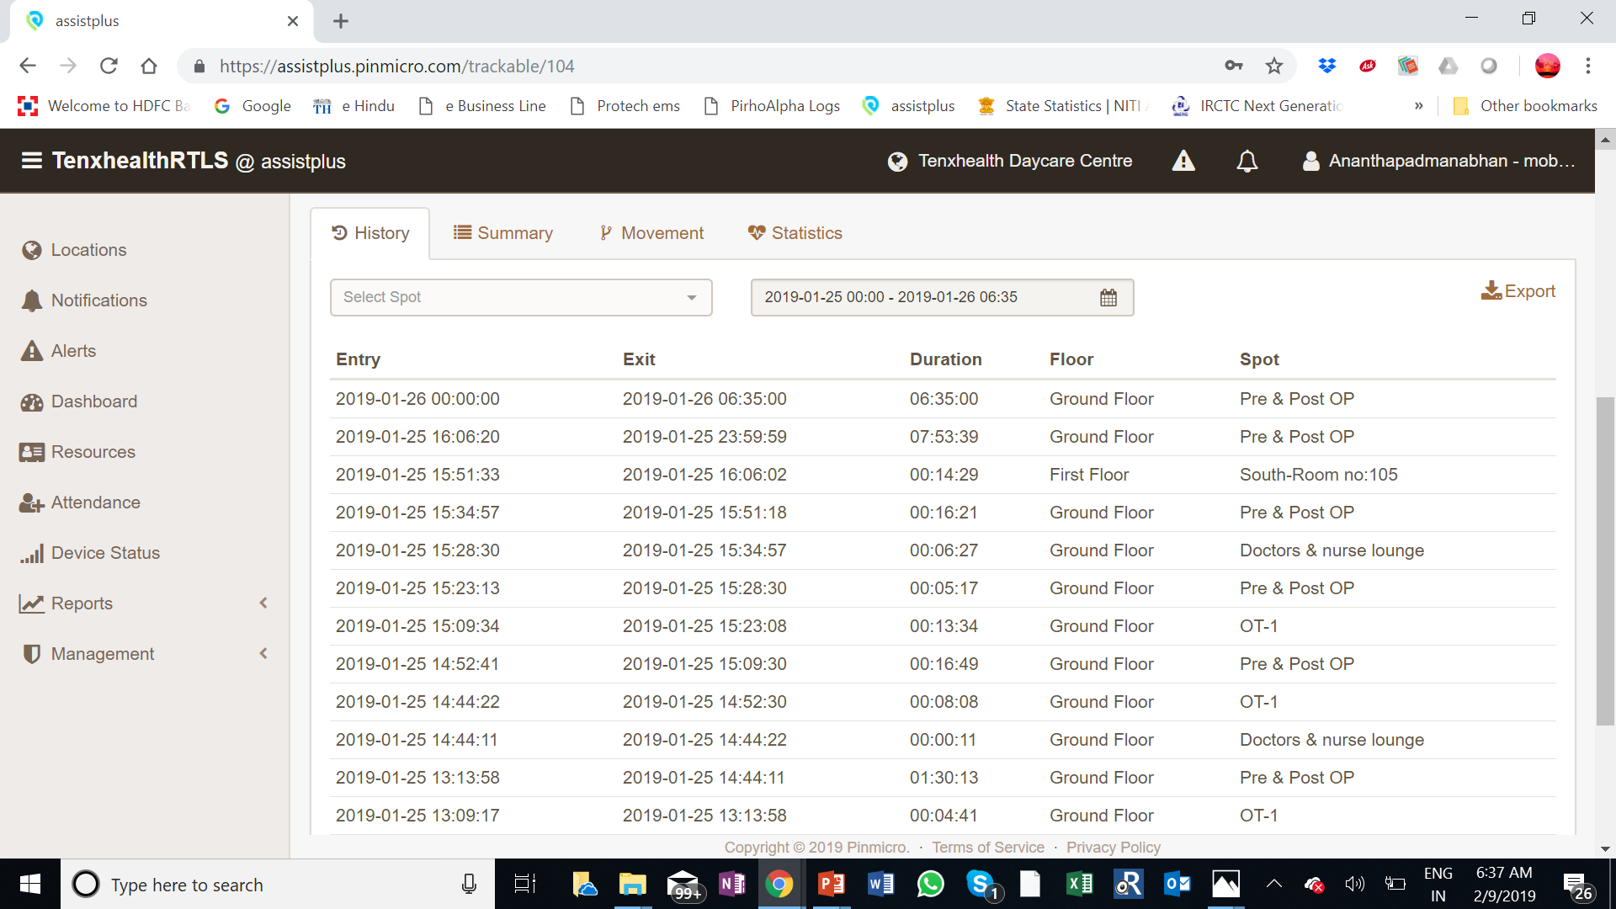

Slide 54
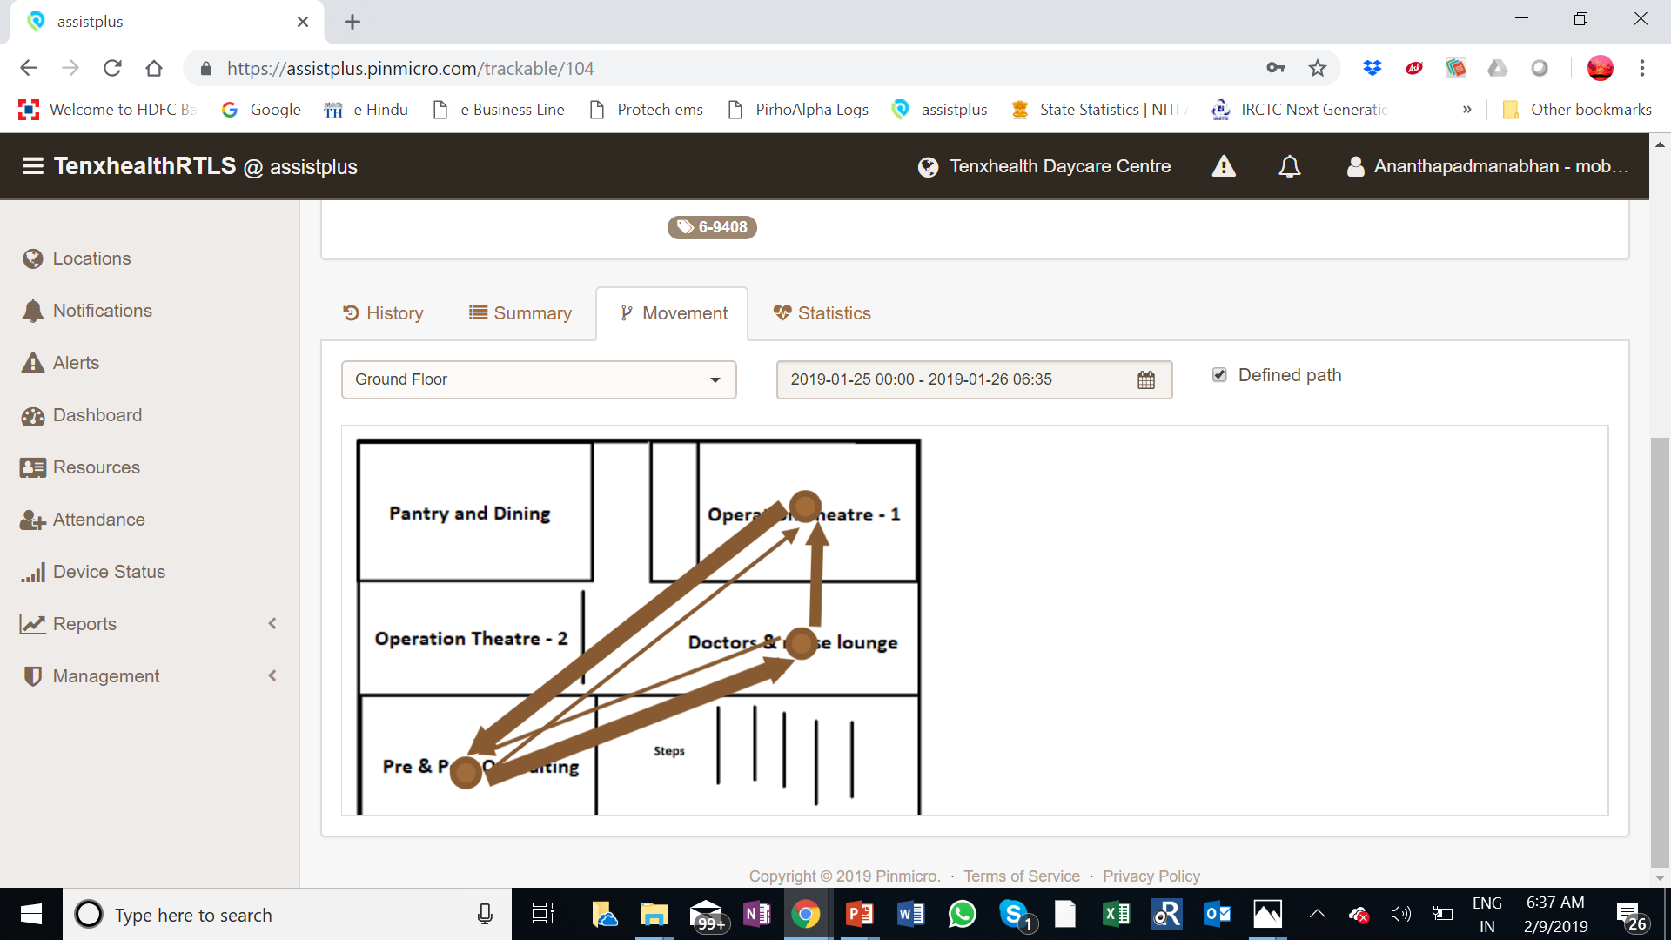

Slide 55
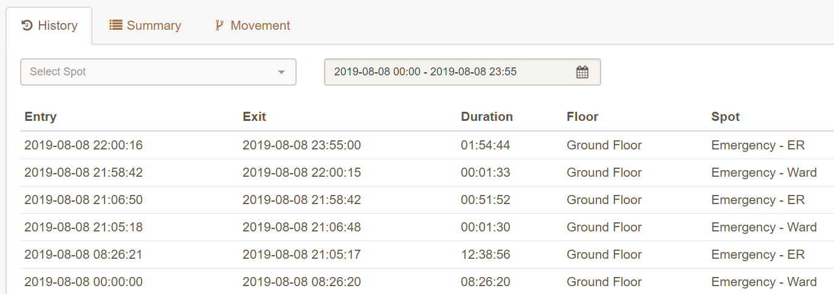
RTLS Asset Tracking

Slide 56
Energy savings

Slide 57
Energy consumption in hospitals
Hospital buildings consume 3 times the energy of a hotel, Mall or a IT building for per square feet area/per user
Patients and attendants, visitors use the facility 24/7
More infrastructure faculties like CSSD,medical equipment
High intensity of use parking/lifts/water

Slide 58
MONTHLY ELECTRICITY CONSUMPTION DETAILS OF HOSPITALS IN INDIA
Name of the Organisation | No.of Beds | Emp | Sq ft Area | Monthly Con (Ele.Units) | Electricity Charg. in Lacs | MD in KVA | Per.Sq ft Ele. Charge | Per. Bed Unit Con | Per Bed Charges Rs
Kovai Medical Center, Coimbatore. | 350 | 1200 | 365000 | 300000 | 18.00 | 700 | 4.93 | 860 | 5140
Apollo Hospitals, Chennai. | 585 | 3320 | 406690 | 1088200 | 65.29 | 2300 | 16.05 | 1860 | 11160
G.K.N.M Hospital, Coimbatore | 530 | 1310 | 424979 | 305000 | 18.3 | 630 | 4.30 | 570 | 3450
Ganga Hospitals, Coimbatore. | 400 | 1000 | 358000 | 152126 | 9.13 | 360 | 2.55 | 380 | 2280
Meenakshi Mission Hospital, Madurai | 550 | 1591 | 301091 | 280000 | 16.80 | 672 | 5.58 | 510 | 3050
SPS Apollo Hospital, Ludhiana | 350 | 1100 | 325000 | 300000 | 18.00 | 1000 | 5.54 | 860 | 5140
Kavery Medical Centre, Trichy | 400 | 711 | 127000 | 95000 | 5.70 | 204 | 4.49 | 240 | 1420
Rajiv Gandhi Medical College, Thene | 550 | 650 | 320000 | 130000 | 7.80 | 510 | 2.44 | 240 | 1420
Aravind Eye Hospital, Madurai | 285 | 1068 | 121900 | 108000 | 6.48 | 350 | 5.32 | 380 | 2270
Joseph Eye Hospital, Trichy | 300 | 250 | 130000 | 40000 | 2.40 | 300 | 1.85 | 130 | 800
Geeth Ragunath Hospitsl, Salem | 50 | 60 | 5000 | 10500 | 0.63 | nil | 12.60 | 210 | 1260

Slide 59
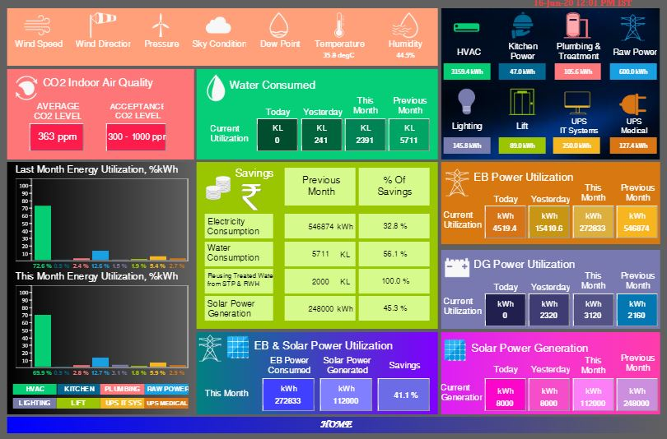

Slide 60
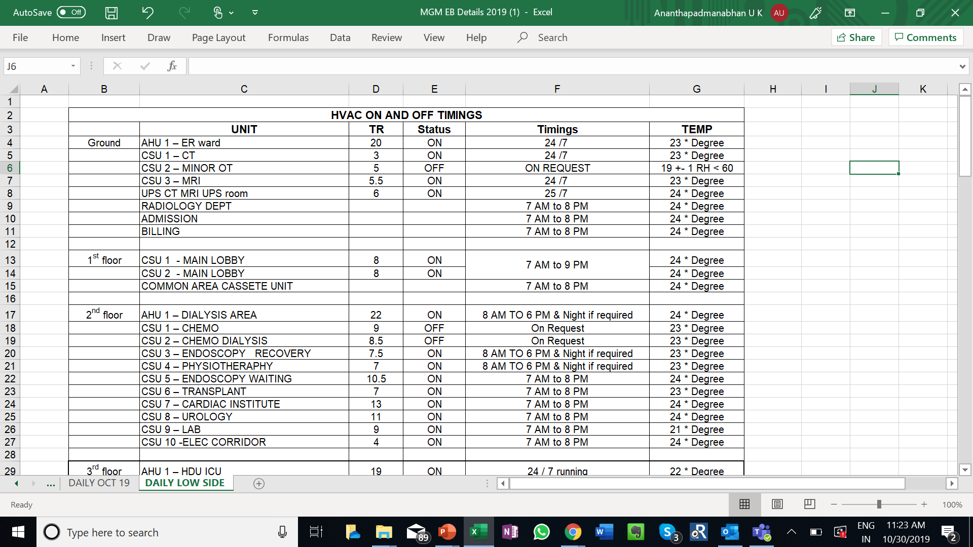

Slide 61
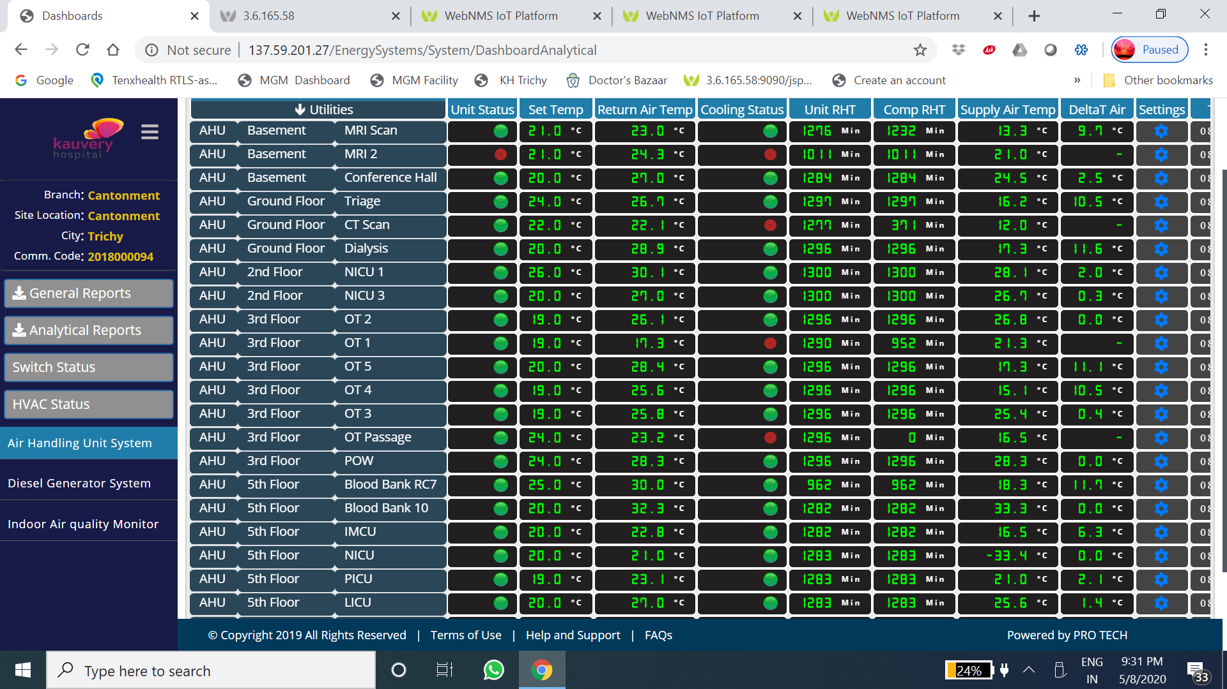

Slide 62
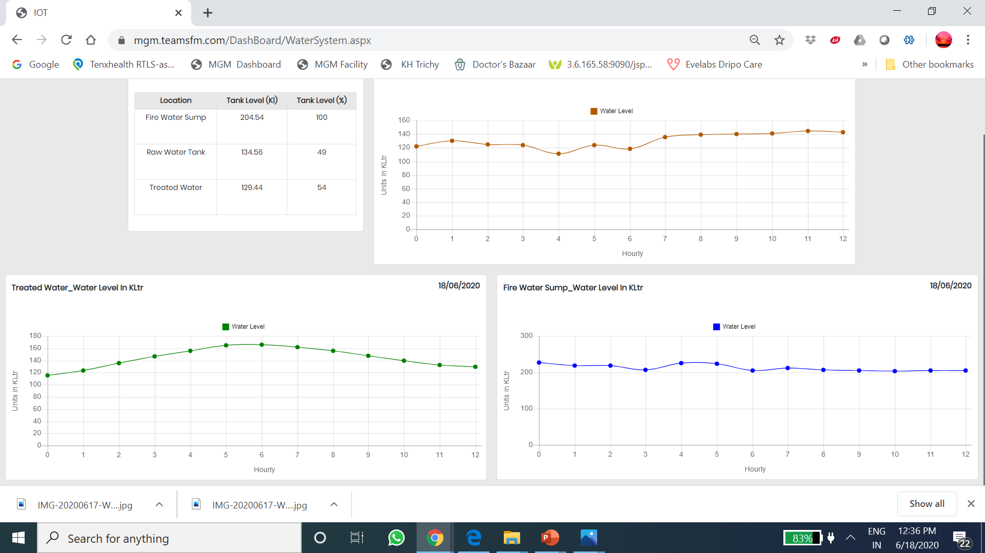

Slide 63
Case Studies - EMS

Slide 64
Compliance and safety

Slide 65
Case study 1 :
No temperature data recorded for 10days

Slide 66
Case study 1: No record of of pharmacy refrigerator temperature data
No recording data
Incomplete record

Slide 67
Case study 2 :
28 degree refrigerator temperature!
Refrigerator door was kept open for long time during stock checking and data logger was also found defective

Slide 69
Case study 2 :
Spike in refrigerator temperature
Refrigerator door was not closed properly many times during the day .

Slide 70
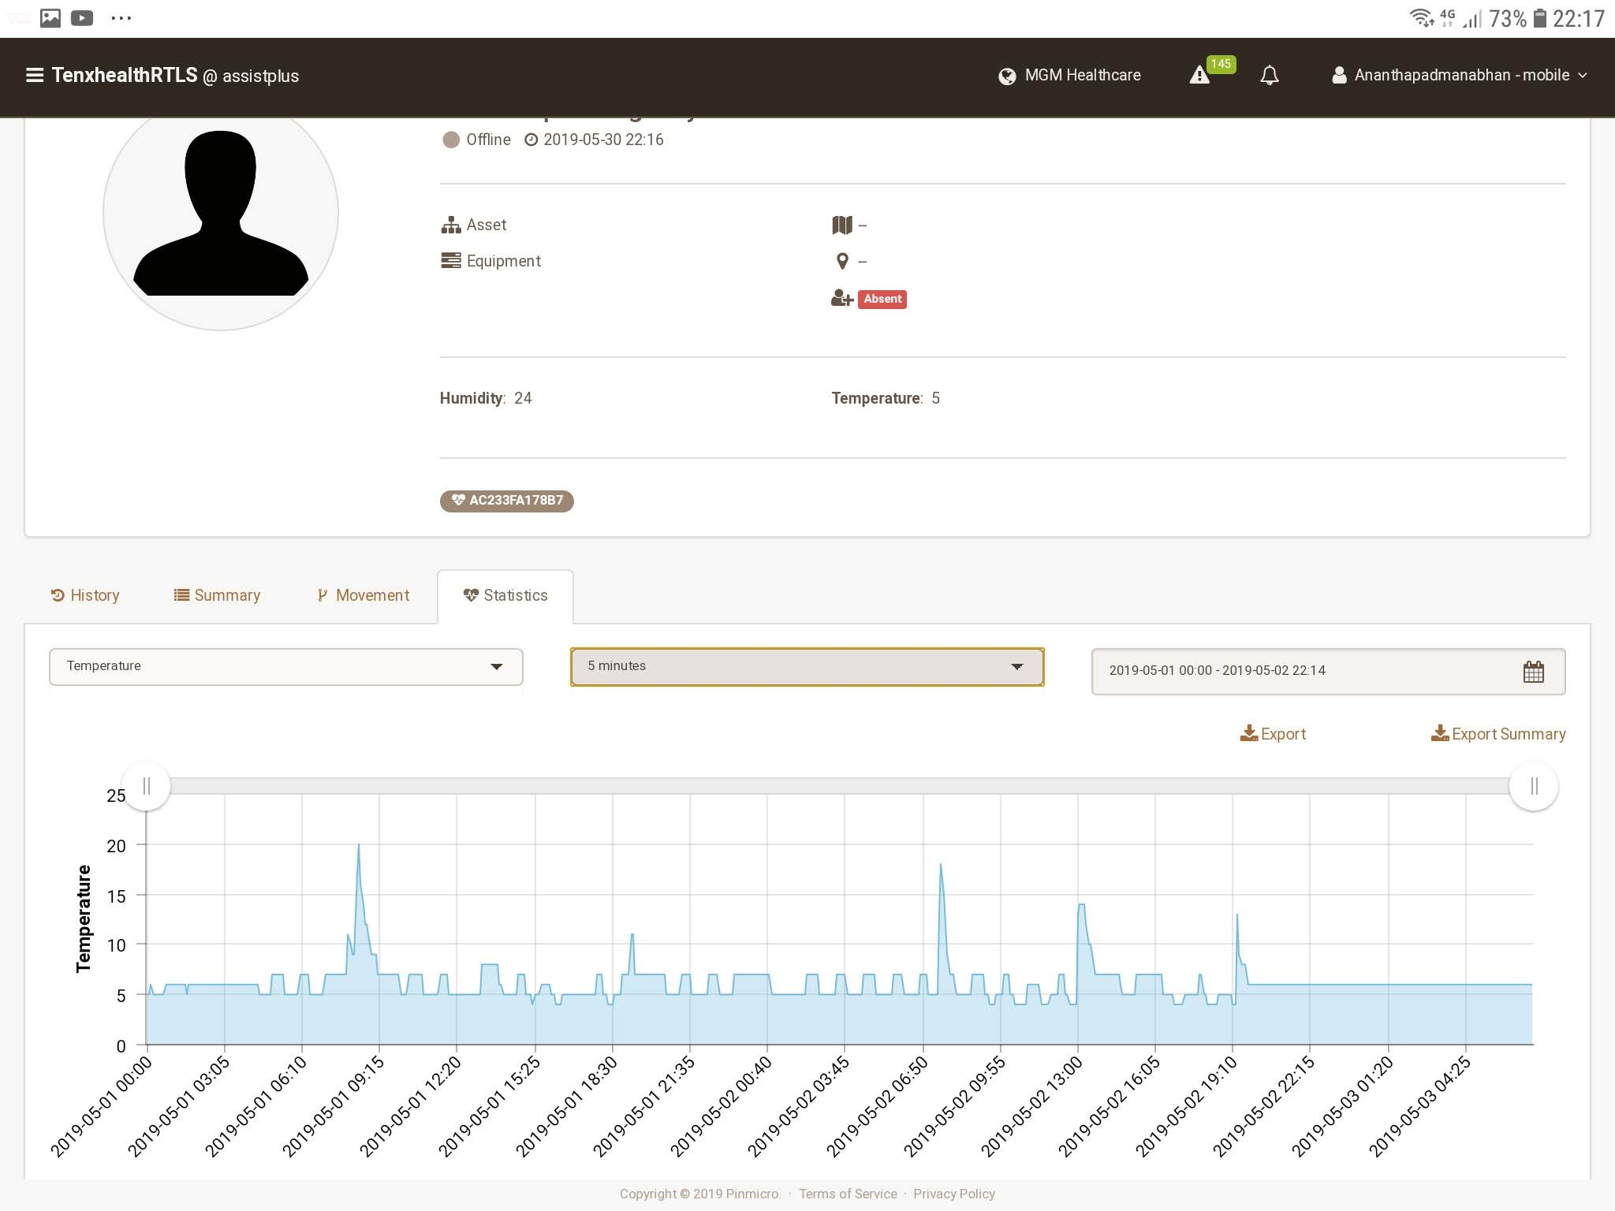

Slide 71
Case study 2 : Spike in refrigerator temperature
Graph indicating spike in ER Refrigerator temperature
SMS alert on temperature change
Email alert on temperature change
Refrigerator door was kept open for long time during stock checking and data logger was also found defective

Slide 72
Thank you
Stay connected and safe!
U K Ananthapadmanabhan
M: 9597033733
E: ananth.uk@tenxhealthtech.com
19th June 2020

